Slide 1
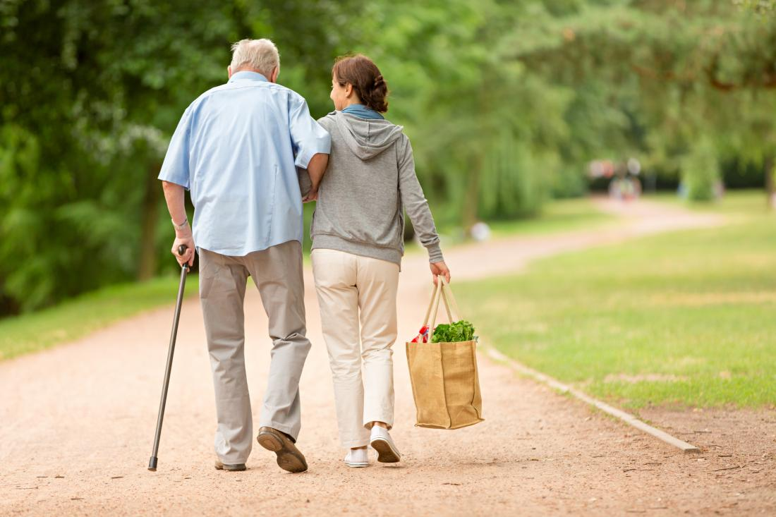
The Gift of Compassion: From God, To Us, and through Us, to Others

Slide 2
Working Definitions
Sympathy: understanding and positive regard and concern for one in need; feeling sorrow, pity for another (sym=with, pathos=suffering)
Mercy: compassion, pity or forbearance shown especially to an offender or to one subject to one's power (eleos)
COMPASSION: a sympathetic consciousness of the distress of the other/love and concern for the other coupled with action; literally, suffering with another (com=with, passion=pathos, suffering)
Empathy: to feel with the other; to experience the feelings, thoughts of the other; to put yourself in the shoes of the other (en=in, path=suffering)

Slide 3
High level of empathy characterized by…
Continual focus on other people’s feelings
Regular state of “hyperarousal” –other people never off the radar, constantly compelled to think of others
Excessive concern with others and placing needs of others before appropriate/holy care of self
Inner disposition determined by others’ situations (“If everyone else is happy, I’m happy.”)
Asymmetrical relationships—give and do not receive
(Adapted from work of Baron-Cohen and Helgeson & Fritz)

Slide 4
Research shows that Compassion…
is learned
has biological and neurological components
is innate; humans have a natural compulsion to help those who are suffering.
In men compassion is primarily manifested through protection; in women through nurture.

Slide 5
Compassion in Old Testament Hebrew: Racham
Deep seated emotional feelings that drive us to aid/ comfort those in distress; feeling that lies behind acts of mercy
One of the many words used for “love” in the Hebrew OT
Related to maternal instincts of a mother for her child from the womb

Slide 6
Compassion in the OT usually refers to …
--God’s pardon, forgiveness, and restoration of His people, the Israelites, after they have fallen/turned away from Him… “But the Lord was gracious to them and had compassion on them; he turned toward them, because of his covenant with Abraham, Isaac, and Jacob, and would not destroy them. . .” (2 Kings 13:23)
--or maternal instincts, a mother’s compassion for her child. . . “Can a women forget her nursing child, and have no compassion on the son of her womb? Even these may forget, but I will not forget you.” (Isa. 49:15)

Slide 7
NT Greek: Splahna/Splahnizome
The heart; the center of feelings; the seat of emotions
The womb; the loins; the bowels
Inner disposition that leads to acts of mercy
To be moved to compassion, as to one’s bowels
Bowels believed to be the seat of love and pity in the body

Slide 8
Feeding of the 4000 (Matthew 15:29-39)
Many are gathered on a mountainside near the Sea of Galilee and Jesus heals them of diseases and infirmities... Jesus tells the disciples: “I have compassion for the crowd, because they have been with me now for three days and have nothing to eat; and I do not want to send them away hungry, for they might faint on the way.”

Slide 9
Parable of the Good Samaritan (Luke 10:25-37)
“But a certain Samaritan, who was on a journey, came upon him; and when he saw him, he felt compassion. He went to him and bandaged his wounds. . .”
(10:33)

Slide 10
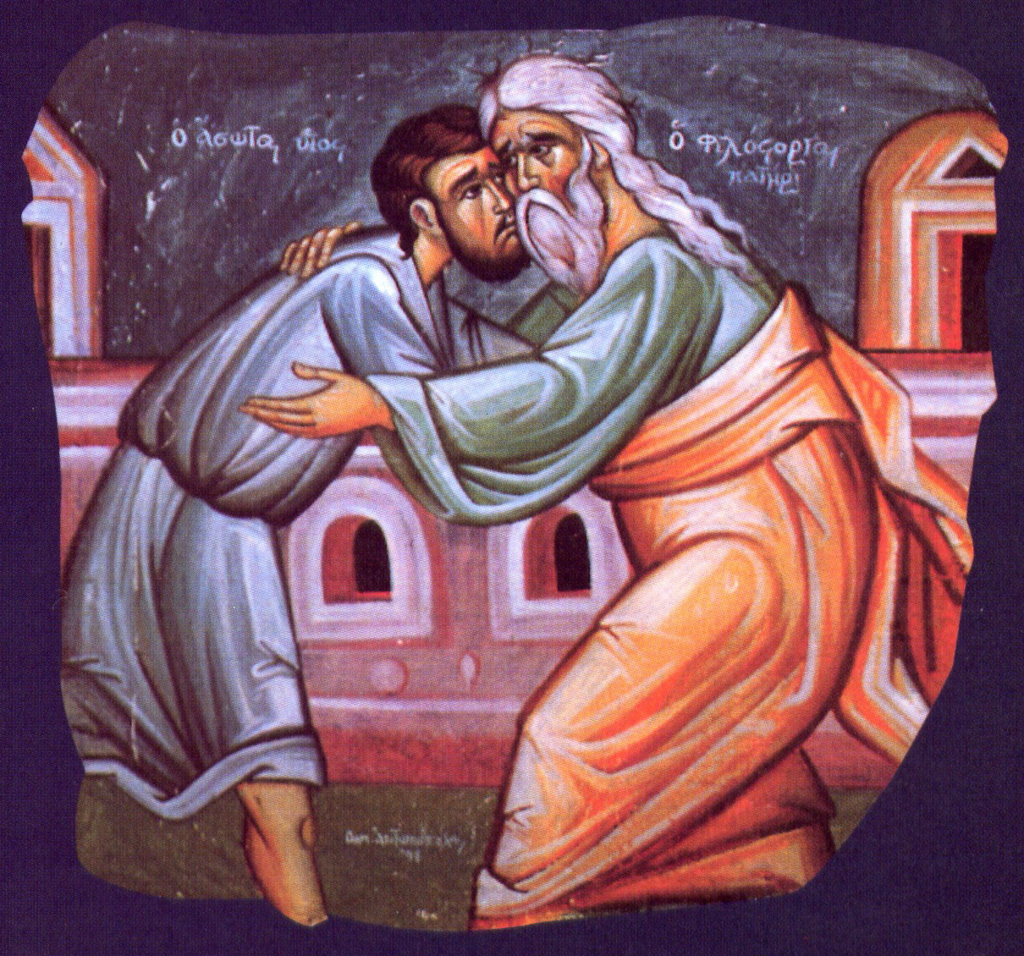
Parable of the Prodigal Son (Luke 15:11-32)
“And he got up and came to his father. But while he was still a long way off, his father saw him, and felt compassion for him, and ran and embraced him, and kissed him.”

Slide 11
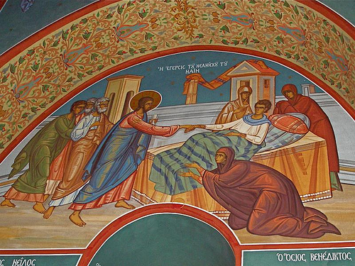
The Widow’s Son at Nain (Lk. 7:11-17)
“. . . when the Lord saw her [the widow], he had compassion on her and said, ‘Do not weep.’ And he came and touched the bier…. And he said, ‘Young man, I say to you, arise.’ And the dead man sat up and began to speak. And he gave him to his mother.”

Slide 12
Henri Nouwen on The Widow’s Son at Nain:
“Compassion means to suffer with, to live with those who suffer. When Jesus saw the woman of Nain he realized, this is a widow who has lost her only son, and he was moved by compassion. He felt . . . pain . . . in his guts. He felt . . . pain so deeply in his spirit that out of compassion he called the son to life so he could give that son back to his mother.”

Slide 13
“The Incomparable Compassion of Christ on the Cross” (Saint Augustine)

Slide 14
God in His infinite love is the Source of all compassion, which grows in us as we live and breathe the life in Christ. We are the vessels through whom God’s compassion flows to others.

Slide 15
Compassionate Responses in Dialogue:
Convey the message that you have time for the person; make eye contact, sit at eye level, touch appropriately
Allow the person to tell her story
Provide a safe, non-judgmental, sacred space
Ask a few open-ended questions if needed
Set appropriate boundaries
Know your limitations
Listen to hear and understand/active listening
Pray silently
Know that silence is ok

Slide 16
Uncompassionate Responses in Dialogue
Use platitudes, such as:
God never gives us more than we can handle;
Everything happens for a reason;
I understand what you are going through;
I know how you feel;
It could be worse;
everything will be ok . . .
Make it about yourself
Try to fix the situation/carry the bag for the person
Fish for information/detail
Give unsolicited advice
Put yourself over the other person

Slide 17
A Model for the “Listening” Face of Compassion
“When we talk to our fellow men and they tell us about their troubles, we will listen to them carefully if we have love for them. We will have compassion for their suffering and pain, for we are God's creatures; we are a manifestation of the love of God.” (Elder Thaddeus of Vitovnica)

Slide 18
Humanity and Compassion
Made in the image of God the Holy Trinity, in the image of love, it is only through compassion—through our ability to suffer with and for others in loving and generous companionship—that we become truly human.
(Metropolitan Kallistos Ware, Divine Compassion Conference hosted by St. Catherine’s Vision, 2015)

Slide 19
Faces of Compassion…
Touch
Celebration
Meeting an immediate, present need
Listening and hearing
Providing for a distant need
Anticipating needs and acting on them
Laying down our life for the other
Silence
Words of comfort
Presence…

Slide 20
Growing in Compassion…
Dependence on Christ as The Source
Appropriate healthy/holy self-care
The ability to feel for the pain of the other while maintaining one’s own integrity of personhood
Concern for others not obsessive
Outward circumstances do not dictate inner well-being
The ability to both give and receive

Slide 21
Finally, let us remember the Mother of “The Compassionate One,” and the Mother of us all, and pray together:
To the Theotokos let us run now most earnestly, we sinners all and wretched ones, and fall down in repentance from the depths of our souls: O Lady, come unto our aid, have compassion upon us; hasten thou for we are lost in a throng of transgressions. Turn not your servants away from empty hands, for you alone do we have as our only hope. (Hymn from Service of Paraklesis)

